Slide 1
Design and Implementation of a Portable ECG Thapathali Campus, Institute of Engineering, Tribhuvan University
Sudip Bhujel, Sulove Bhattarai, Santosh Adhikari

Slide 2
Overview
Introduction
Objectives
Literature Review
System Description and Implementation
Results
Conclusion and Future Enhancements

Slide 3
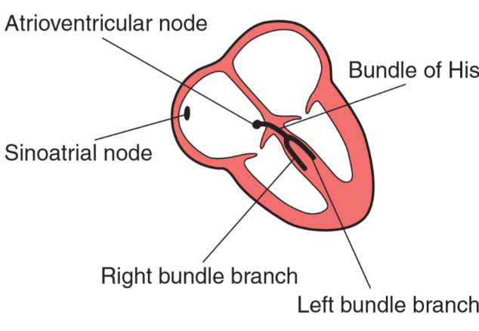
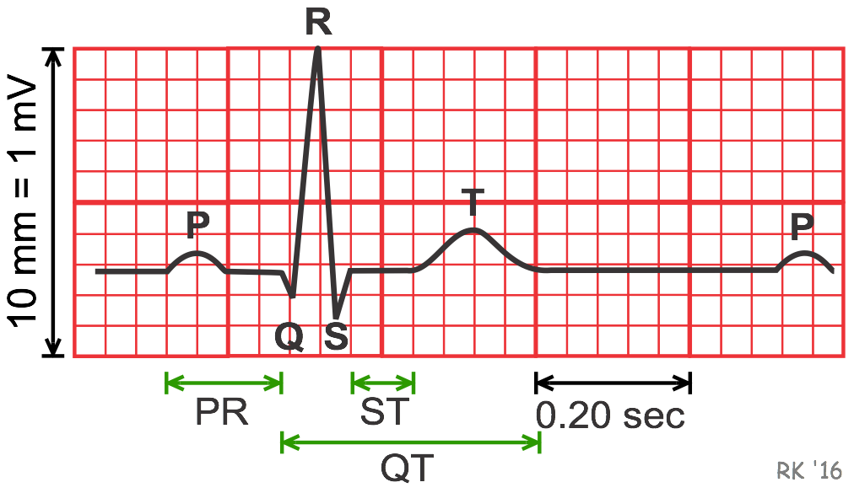
Introduction
Electrocardiography(ECG) is the technology of measuring the electrical changes of the heart.
Potential developed in body is captured by the electrodes.
The contraction and relaxation of the heart muscles are associated with a change in the electrical charges.
Recording of the heart electrical activity during
each of its cycles.

Slide 4
Objectives
To present ECG on the display unit i.e. OLED.
To computer Beats per Minute (BPM) in the real time.

Slide 5
Literature Review
A history of ECG could be tracked from the discovery of the electrical activity of the heart by Köllicker and Müller in 1856.
First ECG of a human recorded with a siphon instrument in 1870 by Muirhead in London.
Breakthrough in ECG technology with invention of the string galvanometer by Einthoven in 1901.
Einthoven proposed theory of three electrodes in 1906 in terms of triangle
Dr. Taro Takemi invented the new portable ECG machine in 1937.
In 1999, researchers from Texas transmitted the 12- lead ECG through wireless technology to computer.

Slide 6
System Description and Implementation
Human body
Electrode
sensors
AD8232 Amplifier
Right hand(-IN)
Left hand(+IN)
Right leg
IA (Instrumentation Amplifier)
Reference buffer
Operational Amplifier
RLD
Amplifier
GND
Vcc
O/P
LO-
LO+
OLED
(SH 1106)
ATmega 328P
I2C
protocol

Slide 7
System Description and Implementation
Electrodes on Left Arm -> Positive Terminal
Electrodes on Right Arm -> Negative Terminal
Electrodes on Right Leg -> Ground
$Lead I=Potential of (Left Arm −Right Arm)$
AD8232 amplifies voltage and sends it to Atmega328P
Calculation of Beats per min by ATmega328P

Slide 8
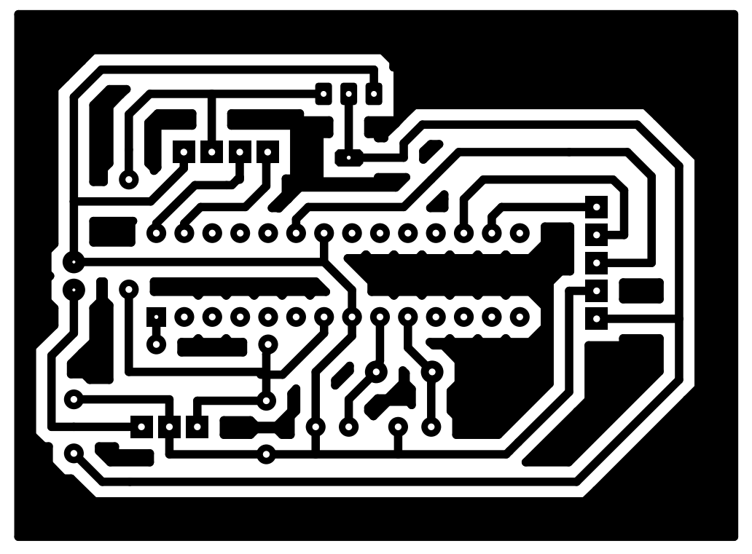
System Description and Implementation
Fig: PCB Diagram for ATmega328P and its components
Fig: ATmega328P Circuit Diagram

Slide 9
System Design and Implementation
I2C communication between ATmega328P and SH1106 OLED to display result
SH1106 OLED 116 pixel in x-axis and 64 pixel in y- axis
Utilization of Adafruit Library called Adafruit_GFX to plot the ECG graph
$BPM= \frac{60}{Time instant between two successive R}$

Slide 10
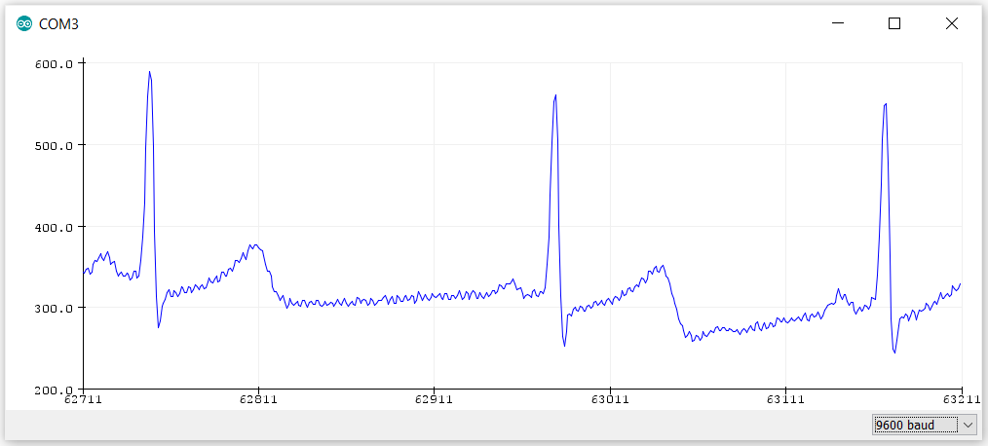
Results
Fig: Output of AD8232 in the Serial Plotter

Slide 11
Results
Fig: Output of AD8232 in the Serial Plotter

Slide 12
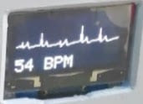
Results

Slide 13
Results

Slide 14
Conclusions and Future Enhancements
Economical and Portable Device which can be used by medical students to understand the ECG device
Electrode pop- up or movement noise increases probability of disturbances.
Electrode probes, cables, signal processor are the major sources of noise.
Extraction of images and store it in database
Machine Learning Implementation to explore arrythmias of the heart

Slide 15
Thank You

